Slide 1


Group 5

Slide 2
What is it?
A competitive networked multiplayer race game for 3-5 players.
Simultaneous, symmetric gameplay.
PC standalone.
Approx. 6 minutes of desired playtime per round.

Slide 3
Who’s it for?
Males aged 10-15
Fans of mascot-driven games (e.g. Ratchet and Clank, Sonic etc.).
Interested in multiplayer competitive skill-based games (TF2).

Slide 4
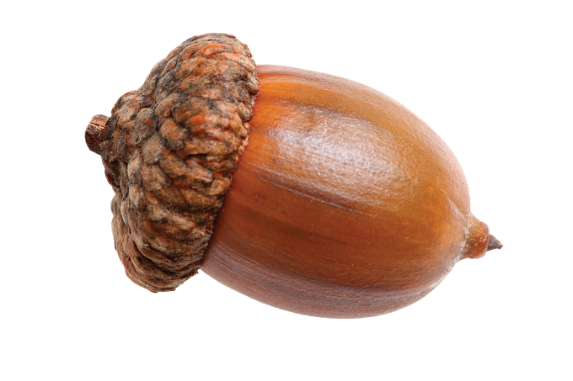
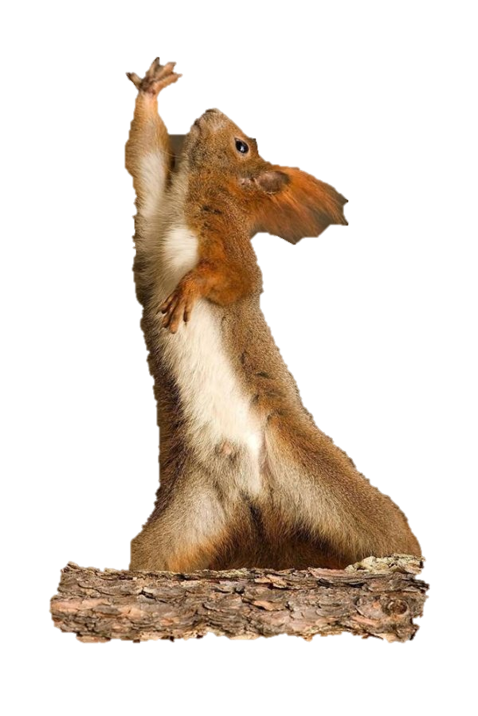
Emotions and Challenges
Tension and release
Fiero
Physical challenges
Twitch
Dexterity
Precision
Mental challenges
Prediction
Strategy
Memorisation
Coordination

Slide 5
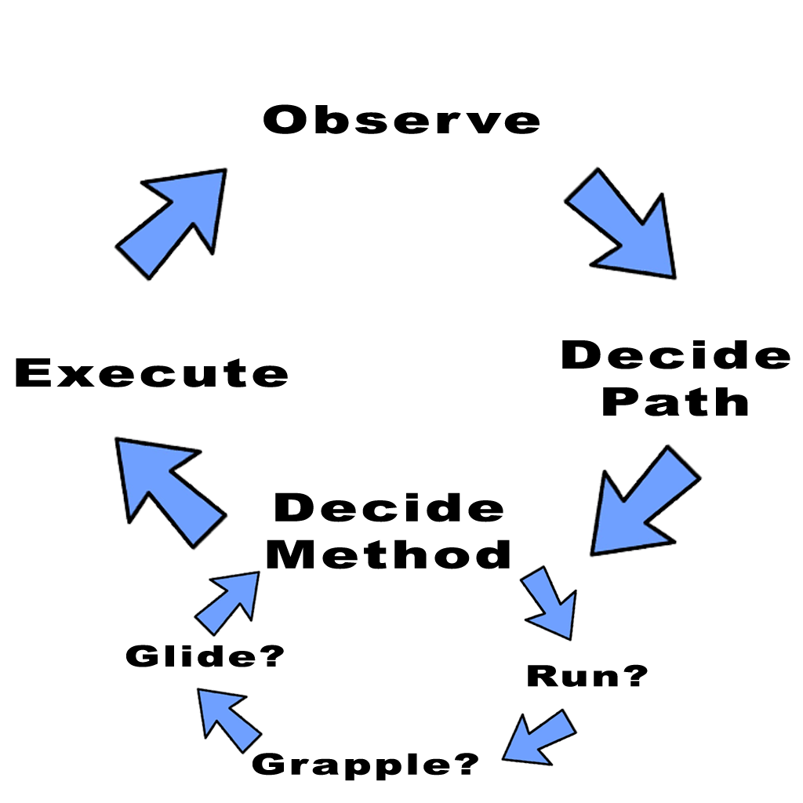
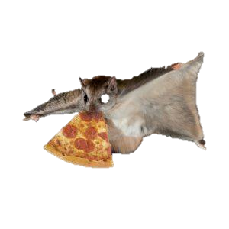
What do they do?
Overall goal:
Obtain 3 nuts before anyone else.
Descend the hill
Grab a nut
Return to base
Notes:
Core game loop:
Observe the level and potential paths through it.
Decide on the optimal path through the map.
Decide the method to achieve that route (ground movement/grapple/glide)
Execute.
Overall goal:
Obtain 3 nuts before anyone else.
Descend the hill
Grab a nut
Return to base

Slide 6
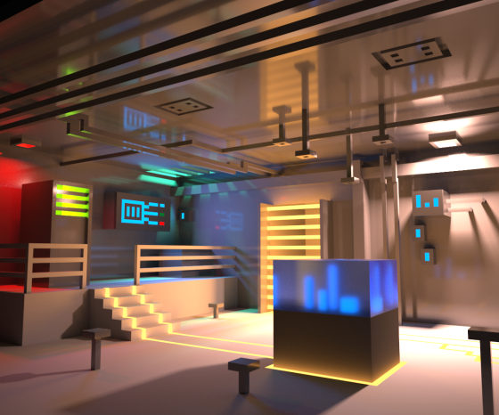
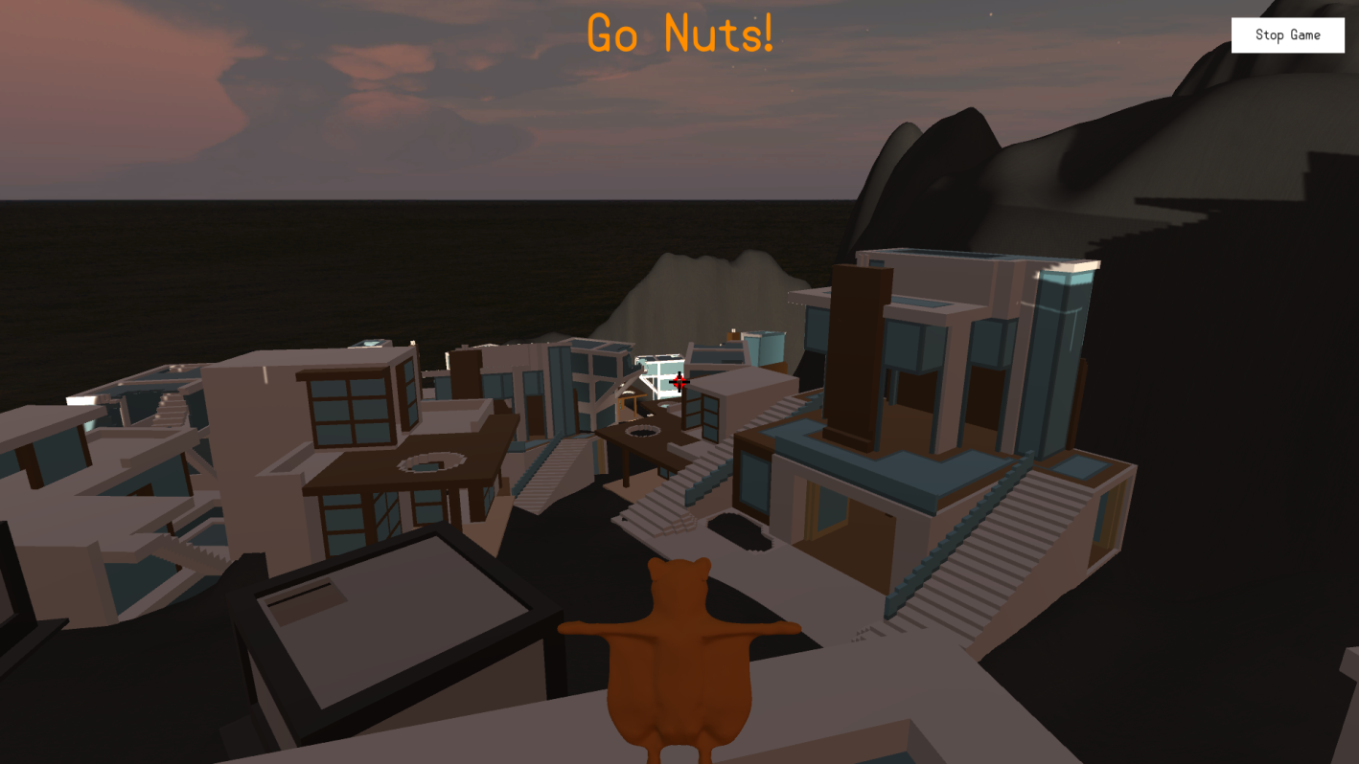


What does it look like?

Slide 7
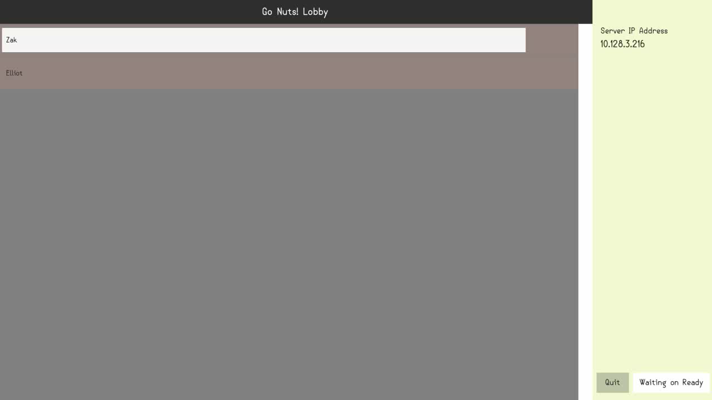
The Gameplay
EMBED A YOUTUBE LINK OR SOMETHING, OTHERWISE VIDEO HAS TO BE ON THE MACHINE!!!

Slide 8
Feedback
Enjoyed the multiplayer
The grappling mechanics were fun to use
“I had no idea where to go”
There is little guidence for the player
Hard to scale some of the buildings
Couldn’t see the grapple cooldown timer

Slide 9
Going forward
Level design changes/iterations.
Lighting/layout/guidance.
UI design and implementation
Further playtesting
Player character texturing / animations

Slide 10
Questions?
Elliot Page – Max Carter – Zachari Cooper – Rebecca Brannum – Joe Wilson

